Slide 1

Online Compiler Using Cloud Computing
Computer Science Project I – CS691
Anchal Singh, Ramesh Kyasaram, Tushar Rakholiya, Sanath Gholap & Harshada Chaudhari

Slide 2
introduction
Importance of cloud computing and why we decided to use it in our project.
Advantages of using Online Cloud Compiler.
Brief Workflow of the project.

Slide 3
objective
Definition of Cloud Computing
Features of Cloud Computing
Aim of the project

Slide 4
System design
Registration
Login
Make new Project/File
Open Project/File
Delete Project/File
Save
Compile
Run
Debug
Share

Slide 5
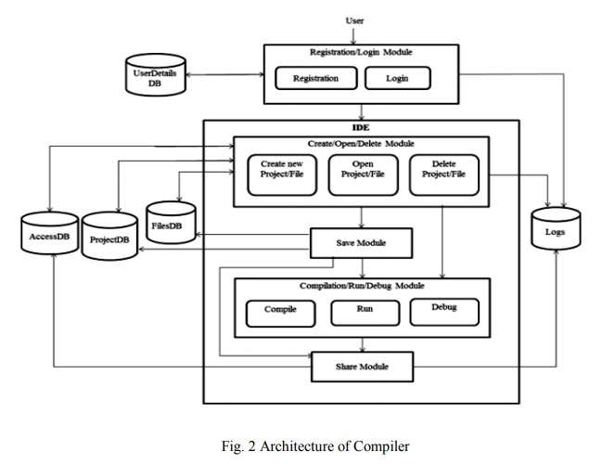

Slide 6
implementation
Web Services
Application Server
Communication Protocol

Slide 7
Service Registry
Publish
Service Provider
Bind
Service Requester
Find
Services Description
WSDL UDDI
WSDL UDDI
Web Service
SOAP

Slide 8
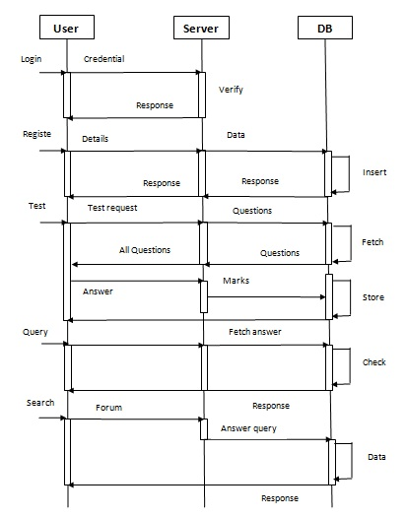

Slide 9
Analysis & conclusion
Benefits for the students.
Contribution to the current examination system.
Provides a platform for students to give practical examination.

